Slide 1
Emotions Infographics
Here is where the template begins

Slide 2
Emotions Infographics
Cheerfulness
Happiness
Earth is the third planet from the Sun
Planet Mercury is the closest object to the Sun
Revengeful
Fatigue
Neptune is the farthest planet from the Sun
Despite being red, Mars is a cold place
Sadness
Frustration
Saturn is composed of hydrogen and helium
Jupiter is a gas giant and the biggest planet

Slide 3
Emotions Infographics
Happy
Despite being red, Mars is a cold place
Excited
Planet Mercury is the closest object to the Sun
Disappointed
Jupiter is a gas giant and the biggest planet
Sad
Neptune is the farthest planet from the Sun

Slide 4
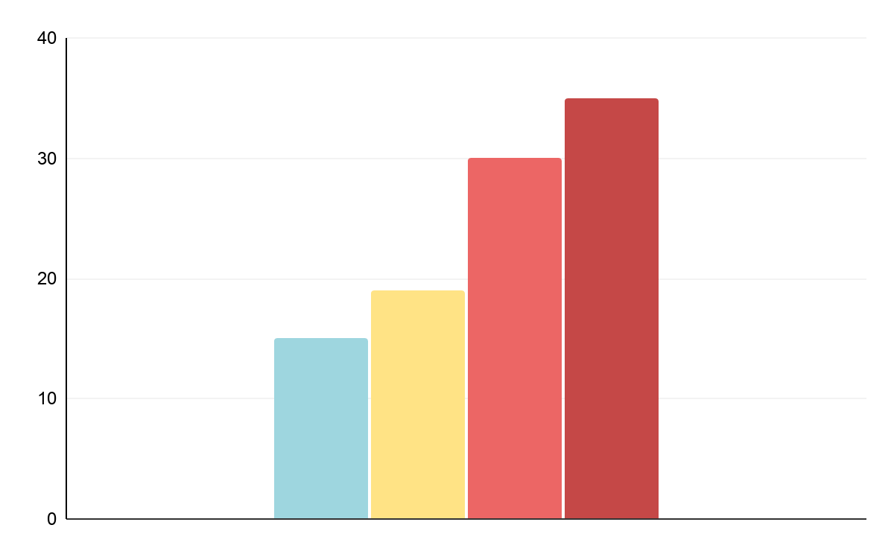
Emotions Infographics
Sad
Despite being red, Mars is a very cold place
Happy
Mercury is the closest planet to the Sun
Surprised
Earth is the third planet from the Sun
In love
Venus has a beautiful name, but it’s hot

Slide 5
Emotions Infographics
Good and bad emotions
Happiness
Sadness
01
Earth is the third planet from the Sun
Planet Mercury is the closest object to the Sun
01
Gladness
Disappointment
02
Neptune is the farthest planet from the Sun
Despite being red, Mars is a cold place
02
Joy
Anger
03
Saturn is composed of hydrogen and helium
Jupiter is a gas giant and the biggest planet
03

Slide 6
Emotions Infographics
Emotions when you are falling in love
Embarrassed
Playful
Happy
Excited
In love
Earth is the third planet from the Sun
Neptune is the farthest planet from the Sun
It’s composed of hydrogen and helium
Despite being red, Mars is a cold place
Mercury is the closest object to the Sun

Slide 7
Emotions Infographics
Things that make you being tired
Not sleeping well
Not eating well
Earth is the third planet from the Sun
Planet Mercury is the closest object to the Sun
Stress
Sedentary lifestyle
Neptune is the farthest planet from the Sun
Despite being red, Mars is a cold place
Bad organisation
Not drinking water
Saturn is composed of hydrogen and helium
Jupiter is a gas giant and the biggest planet

Slide 8
Emotions Infographics
Pleased
90%
Planet Mercury is the closest object to the Sun
Worried
40%
Despite being red, Mars is a cold place
Sleepy
60%
Jupiter is a gas giant and the biggest planet

Slide 9
Emotions Infographics
From wellness to discomfort
01
02
03
04
05
Amusement
Happiness
Disappointment
Anger
Sadness
Earth is the third planet from the Sun
Neptune is the farthest planet from the Sun
It’s composed of hydrogen and helium
Despite being red, Mars is a cold place
Mercury is the closest object to the Sun

Slide 10
Emotions Infographics
Happiness
Cheerfulness
Earth is the third planet from the Sun
Planet Mercury is the closest object to the Sun
Anger
Disappointment
Saturn is composed of hydrogen and helium
Despite being red, planet Mars is a very cold place

Slide 11
Emotions Infographics
85%
75%
Cheerful
Worried
Mercury is the closest planet to the Sun and the smallest one
It is the ringed planet. It is composed of hydrogen and helium
45%
65%
Proud
Sad
Jupiter is a gas giant and the biggest object in the Solar System
Despite being red, planet Mars is a very cold place

Slide 12
Emotions Infographics
Happy
Pleased
Surprised
Sad
Despite being red, planet Mars is a very cold place, not hot
Venus has a beautiful name and is the second planet from the Sun
It is the ringed planet. It is composed of hydrogen and helium
Jupiter is a gas giant and the biggest object in the Solar System

Slide 13
Emotions Infographics
Feelings that predominate according to age range
YEARS
Traffic jam
60%
Angry
Neptune is the farthest planet from the Sun
Long queues
20%
Holidays
45%
Cheerful
Despite being red, Mars is a cold place
Pass an exam
65%
Rain
70%
Sad
It is composed of hydrogen and helium
Loneliness
30%

Slide 14
Emotions Infographics
States of emotions at running
Happiness
Satisfaction
Neptune is the farthest planet from the Sun
Mercury is the closest object to the Sun
Fatigue
Motivation
It’s composed of hydrogen and helium
Exhaustion
Earth is the third planet from the Sun
Despite being red, Mars is a cold place

Slide 15
Emotions Infographics
Things that make you being pleased
Hang out with a friend
Eat healthy food
Earth is the third planet from the Sun
Planet Mercury is the closest object to the Sun
Dance
Do sport
Neptune is the farthest planet from the Sun
Despite being red, Mars is a cold place
Listen to music
Sleep properly
Saturn is composed of hydrogen and helium
Jupiter is a gas giant and the biggest planet

Slide 16
Emotions Infographics
The six basic emotions
Happiness
Surprise
Earth is the third planet from the Sun
Planet Mercury is the closest object to the Sun
Sadness
Anger
Neptune is the farthest planet from the Sun
Despite being red, Mars is a cold place
Fear
Exhaustion
Saturn is composed of hydrogen and helium
Jupiter is a gas giant and the biggest planet

Slide 17
Emotions Infographics
Things that make you feel sad
Being sick
Neptune is the farthest planet from the Sun
Mondays
Earth is the third planet from the Sun

Slide 18
Emotions Infographics
Feelings that predominate according to the season of the year
Winter
Spring
Summer
Autumn
Planet Saturn is composed of hydrogen and helium gas
Jupiter is a gas giant and the biggest object in the Solar System
Mercury is the closest planet to the Sun and the smallest one
Despite being red, planet Mars is a very cold place

Slide 19
Emotions Infographics
Where do emotions happen?
Happiness
Anger
Fear
Disgust
Sadness
Earth is the third planet from the Sun
Neptune is the farthest planet from the Sun
It’s composed of hydrogen and helium
Despite being red, Mars is a cold place
Mercury is the closest object to the Sun

Slide 20
Emotions Infographics
Guide to emotional self - care
Learn how to say no
01
Earth is the third planet from the Sun
Breathe deeply
02
Neptune is the farthest planet from the Sun
Watch your sorry
03
It’s composed of hydrogen and helium
Create boundaries
04
Despite being red, Mars is a cold place
Feel your emotions
05
Mercury is the closest object to the Sun

Slide 21
Emotions Infographics
Naughty
Studious
Mercury is the closest planet to the Sun and the smallest one
It is the ringed planet. It is composed of hydrogen and helium
Sadness
Anger
Jupiter is a gas giant and the biggest object in the Solar System
Despite being red, planet Mars is a very cold place

Slide 22
Emotions Infographics
65%
45%
25%
30%
Cheerful
Proud
Pissed off
Gloomy
It’s a gas giant and the biggest object in the Solar System
Despite being red, Mars is actually a very cold place
It is the ringed planet. It is composed of hydrogen and helium
It’s the closest planet to the Sun and the smallest one

Slide 23
Emotions Infographics
5K
Happiness
Earth is the third planet from the Sun
10K
Joy
Neptune is the farthest planet from the Sun
15K
Exhaustion
Saturn is composed of hydrogen and helium
18K
Tiredness
Planet Mercury is the closest object to the Sun

Slide 24
Emotions Infographics
Things that make us happy
Travelling
01
Neptune is the farthest planet from the Sun
Watching a movie
02
Despite being red, Mars is a cold place
Sunbathing
03
It is composed of hydrogen and helium

Slide 25
Emotions Infographics
Cheerfulness
Earth is the third planet from the Sun
450K
Frustration
Neptune is the farthest planet from the Sun
300K
Disappointment
250K
Planet Mercury is the closest object to the Sun

Slide 26
Emotions Infographics
Emotions that predominate when having a pet
Surprised
Proud
Earth is the third planet from the Sun
Planet Mercury is the closest object to the Sun
In love
Fun
Saturn is composed of hydrogen and helium
Jupiter is a gas giant and the biggest planet

Slide 27
Emotions Infographics
Emotional intelligence
01
02
Perceive emotions
Talk about your feelings
Earth is the third planet from the Sun
Planet Mercury is the closest object to the Sun
03
04
Understand emotions
Manage emotions
Saturn is composed of hydrogen and helium
Jupiter is a gas giant and the biggest planet

Slide 28
Emotions Infographics
Personality types
Sleepy
Joke
In love
Worried
Sick
Earth is the third planet from the Sun
Neptune is the farthest planet from the Sun
It’s composed of hydrogen and helium
Despite being red, Mars is a cold place
Mercury is the closest object to the Sun

Slide 29
Emotions Infographics
Happiness
Boredom
Jupiter is a gas giant and the biggest object in the Solar System
Mercury is the closest planet to the Sun and the smallest one

Slide 30
Emotions Infographics
Emotions that predominate on a trip
Proud
Curious
Earth is the third planet from the Sun
Planet Mercury is the closest object to the Sun
Joy
Surprise
Neptune is the farthest planet from the Sun
Despite being red, Mars is a cold place
Fatigue
Cheerfulness
Saturn is composed of hydrogen and helium
Jupiter is a gas giant and the biggest planet

Slide 31
Emotions Infographics
What to do to feel better on a bad day
Go for a walk
Planet Mercury is the closest object to the Sun
Meet a friend
Saturn is composed of hydrogen and helium
Do sport
Neptune is the farthest planet from the Sun
Go for a walk
Watch a movie
Planet Mercury is the closest object to the Sun
Earth is the third planet from the Sun

Slide 32
Instructions for use (premium users)
In order to use this template, you must be a Premium user on Slidesgo.
You are allowed to:
Modify this template.
Use it for both personal and commercial purposes.
Hide or delete the “Thanks” slide and the mention to Slidesgo in the credits.
Share this template in an editable format with people who are not part of your team.
You are not allowed to:
Sublicense, sell or rent this Slidesgo Template (or a modified version of this Slidesgo Template).
Distribute this Slidesgo Template (or a modified version of this Slidesgo Template) or include it in a database or in any other product or service that offers downloadable images, icons or presentations that may be subject to distribution or resale.
Use any of the elements that are part of this Slidesgo Template in an isolated and separated way from this Template.
Register any of the elements that are part of this template as a trademark or logo, or register it as a work in an intellectual property registry or similar.
For more information about editing slides, please read our FAQs or visit Slidesgo School:
https://slidesgo.com/faqs and https://slidesgo.com/slidesgo-school

Slide 33
Premium infographics...
Text 1
Text 2
Text 3
Add the Title here
2016
2017
2018
2019
2020
Text 4
Text 5
Text 6
“Mercury is closest planet to the Sun and the smallest”
“Despite being red, Mars is a cold place full of iron oxide”
“Venus has a beautiful name and is the second planet”
“Neptune is the farthest-known planet from the Sun”
“Saturn is a gas giant and has several rings”

Slide 34
Premium infographics...
75%
“Mercury is closest planet to the Sun and the smallest”
75%
“Mercury is closest planet to the Sun and the smallest”
TITLE 1
“Mercury is closest planet to the Sun and the smallest”
“Mercury is closest planet to the Sun and the smallest”

Slide 35
Premium Icons

Slide 36
Premium Icons

Slide 37
Premium Icons

Slide 38
Premium Icons

Slide 39
Premium Icons

Slide 40
Infographics
You can add and edit some infographics to your presentation to present your data in a visual way.
Choose your favourite infographic and insert it in your presentation using Ctrl C + Ctrl V or Cmd C + Cmd V in Mac.
Select one of the parts and ungroup it by right-clicking and choosing “Ungroup”.
Change the color by clicking on the paint bucket.
Then resize the element by clicking and dragging one of the square-shaped points of its bounding box (the cursor should look like a double-headed arrow). Remember to hold Shift while dragging to keep the proportions.
Group the elements again by selecting them, right-clicking and choosing “Group”.
Repeat the steps above with the other parts and when you’re done editing, copy the end result and paste it into your presentation.
Remember to choose the “Keep source formatting” option so that it keeps the design. For more info, please visit Slidesgo School.

